Slide 1
Fraud & Perpetrators
Paul Bustos, CFE, CRMA: Forensic & Litigation Services
Tele: 817-882-7341 or 972-448-9251
E-mail: Paul.Bustos@Weaver.com

Slide 2

Outline
What is Fraud?
ACFE 2014 RTTN
Case Study: Receivership
ACFE & Dallas Chapter-ACFE

Slide 3
What is Fraud?

Slide 4
Fraud Definition
A generic term, embracing all multifarious means which human ingenuity can devise and which are resorted to by individual(s) to get advantage over another by
false suggestions or suppression of truth, and includes surprise, trick, cunning, and any unfair way by which another is cheated

Slide 5

Elements of Fraud
Material misrepresentation
Intent to mislead
Reliance
Detriment

Slide 6
The Fraud Triangle
Opportunity
The only factor completely controlled/prevented by an organization
Must gain access to assets/records
Rationalization
  Ability to follow through and commit the fraud
  Perpetrator has to make it “okay” internally to perform the fraudulent act
OPPORTUNTY
RATIONALIZATION
CONCEALMENT
INCENTIVE/PRESSURE
INTENT/MOTIVE
Incentive/Pressure
The more incentive, the easier it is to justify
Financial or personal problems, financial
pressure, mental instability

Slide 7
Primary Categories of Fraud
Asset Misappropriation | Corruption | Financial Statement Fraud
Theft or misuse of tangible and intangible assets | Utilizing influence in business transactions to obtain a personal benefit | Misstatement or omission of material information in financial statements
Most Common | Less Frequent | Most Rare

Slide 8
Asset Misappropriation
Scheme
Scenario
• Payment to fictitious employee
Payroll
• Payment to terminated employees
• Falsifying timesheets for financial gain
• Theft of inventory items
Inventory
• Consistent shrinkage of items
• Increased defective/warranty claims
Credit Cards
• Reimbursement for personal expenses
• Use company card for unauthorized purchases
Larceny
• Theft of office items, petty cash, and merchandise
Purchasing
• Using purchasing authority to purchase raw materials for
personal use
Procurement
• Using procurement card for personal, exorbitant purchases
• Reimbursement for undocumented expenses
Reimbursement
• Reimbursement for miles while using the company vehicle
• Reimbursement for meal expenses of family members
Improper Payments
• Payments to fictitious companies or vendors

Slide 9
Corruption

Slide 10
Financial Statement Fraud
Scheme | Scenario
Fictitious Revenue | • Improper or early revenue recognition • Falsifying revenue • Earnings manipulation through reserves • Recording pending transactions as completed transactions
Overstating Assets | Improper valuation of securities, inventory, fixed assets
Understating Liabilities and Expenses | • Hiding losses in future reporting periods • Understating expense account balances • Reclassifying (capitalizing) expenses as assets • Improper valuation or manipulation of intercompany accounts
Improper Note Disclosure | • Omission of material contingencies or subsequent events
Non-financial | • Falsifying external documents to suppliers • Internal memorandums give misleading information • Publicly announced information provides unsubstantiated favorable results
Manipulating Management Estimates | • Manipulation of management estimates for receivables, goodwill, or depreciation

Slide 11
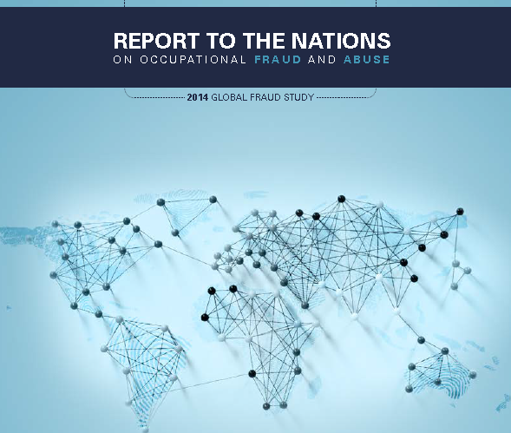
Report To The Nation
©2014 Association of Certified Fraud Examiners, Inc.

Slide 12
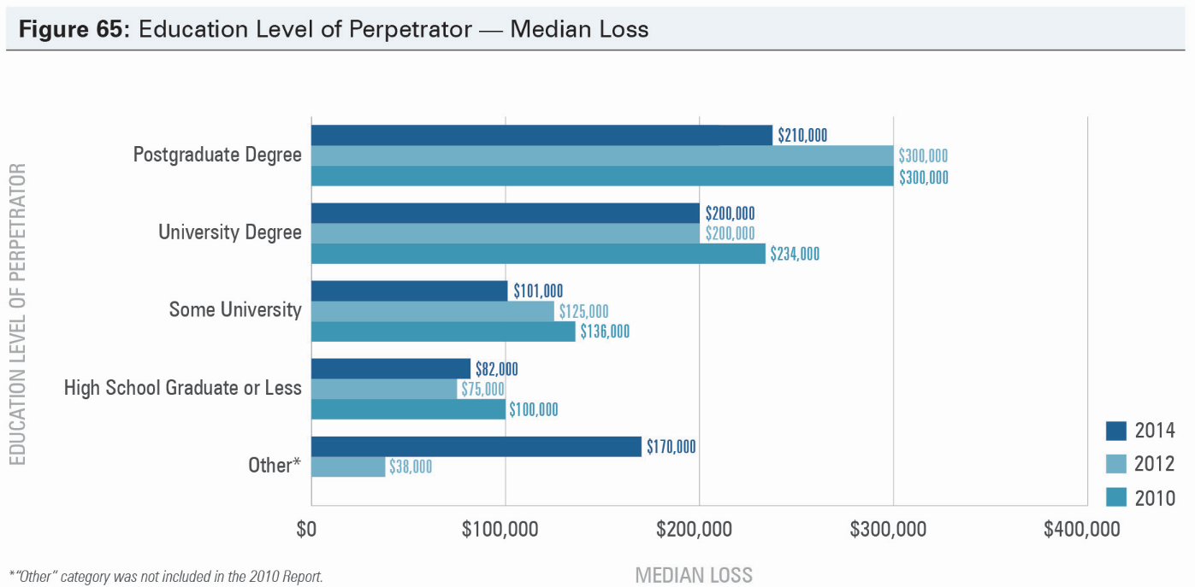
Report To The Nation
©2014 Association of Certified Fraud Examiners, Inc.

Slide 13
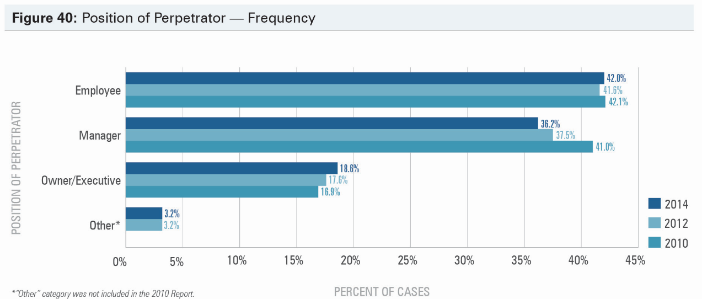
Report To The Nation
©2014 Association of Certified Fraud Examiners, Inc.

Slide 14
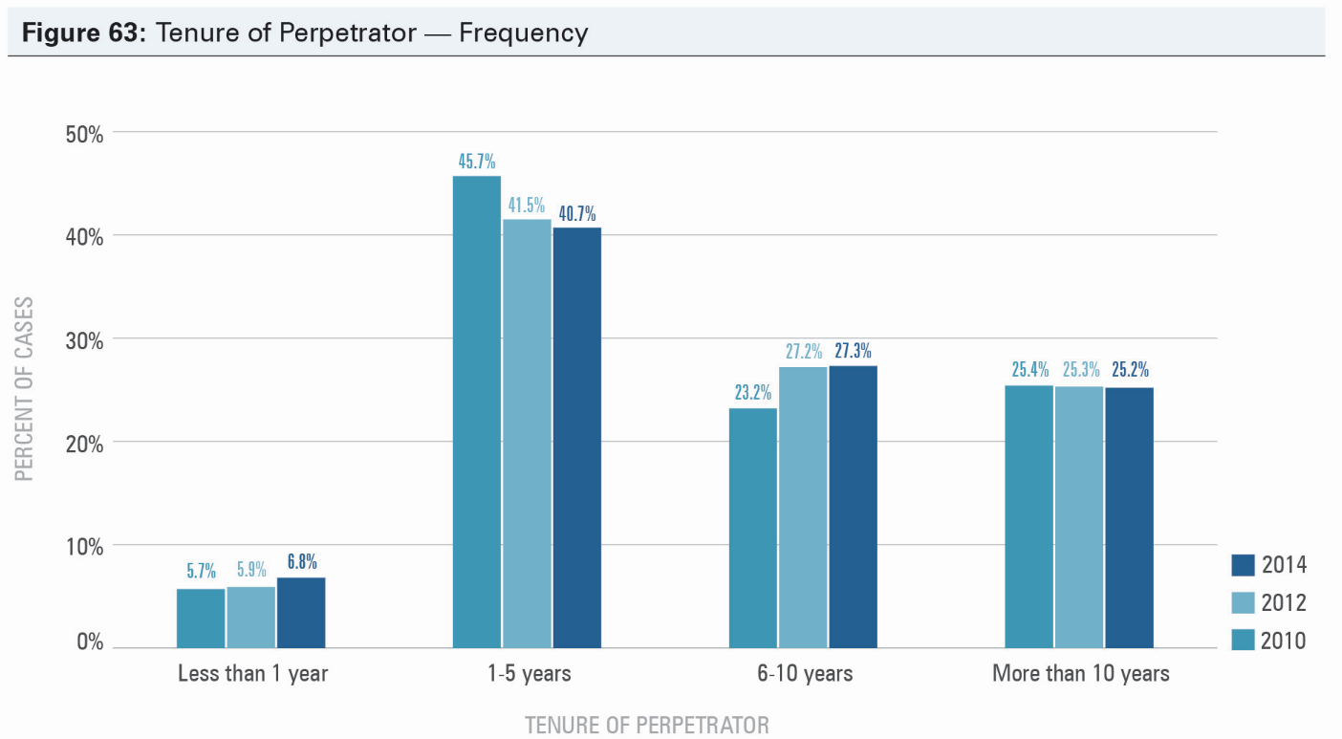
Report To The Nation
©2014 Association of Certified Fraud Examiners, Inc.

Slide 15
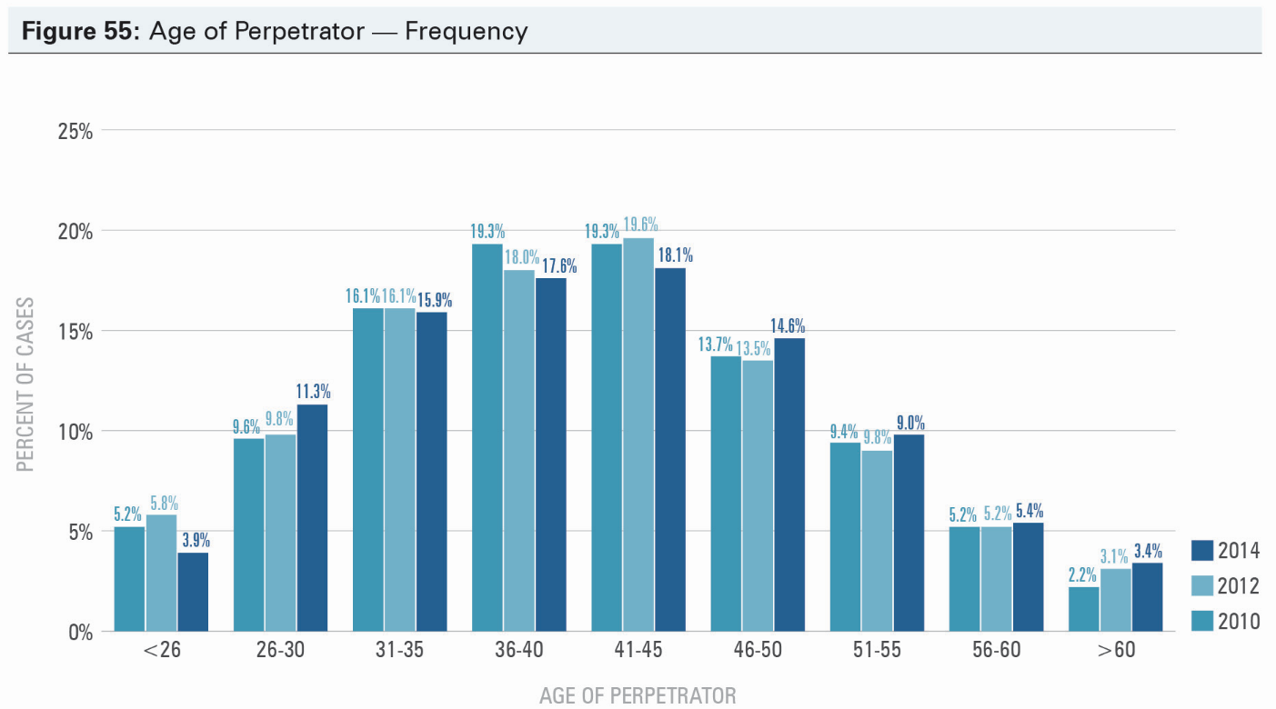
Report To The Nation
©2014 Association of Certified Fraud Examiners, Inc.

Slide 16
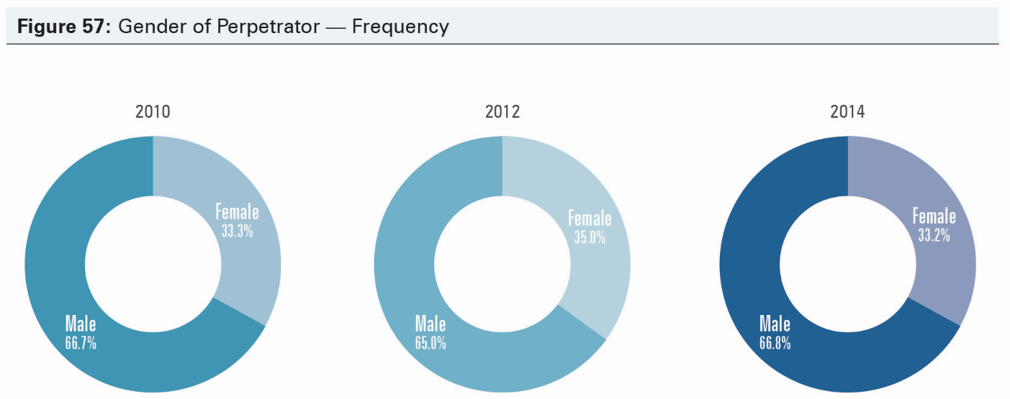
Report To The Nation
©2014 Association of Certified Fraud Examiners, Inc.

Slide 17
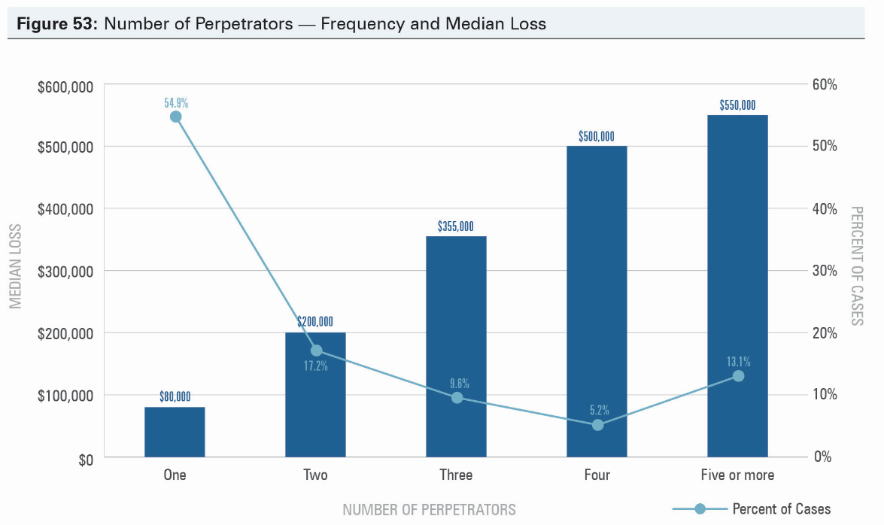
Report To The Nation
©2014 Association of Certified Fraud Examiners, Inc.

Slide 18
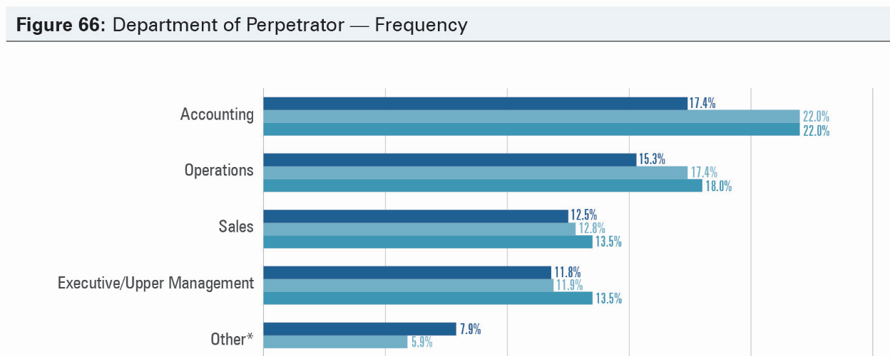
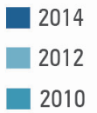
Report To The Nation
©2014 Association of Certified Fraud Examiners, Inc.

Slide 19
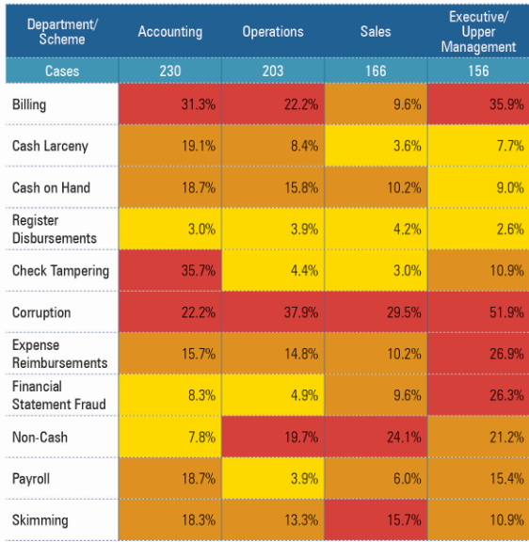

Report To The Nation
©2014 Association of Certified Fraud Examiners, Inc.

Slide 20
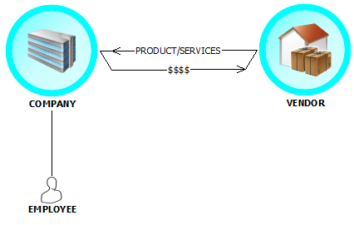
Billing Scheme

Slide 21
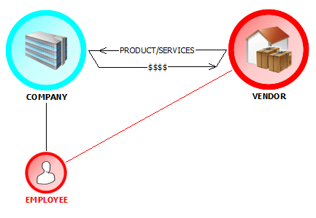
Billing Scheme

Slide 22
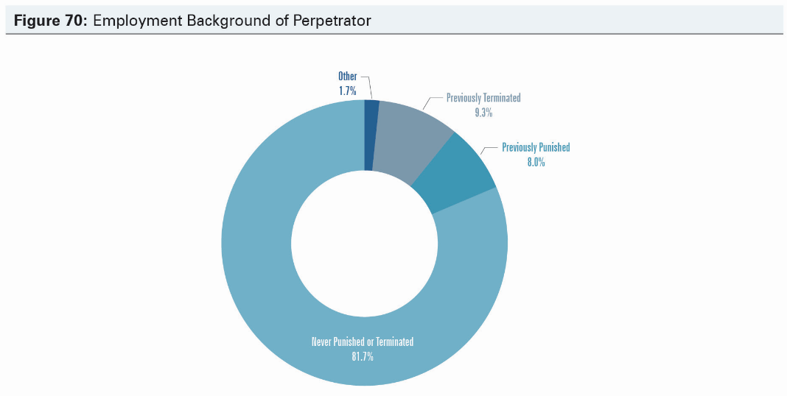
Report To The Nation
©2014 Association of Certified Fraud Examiners, Inc.

Slide 23
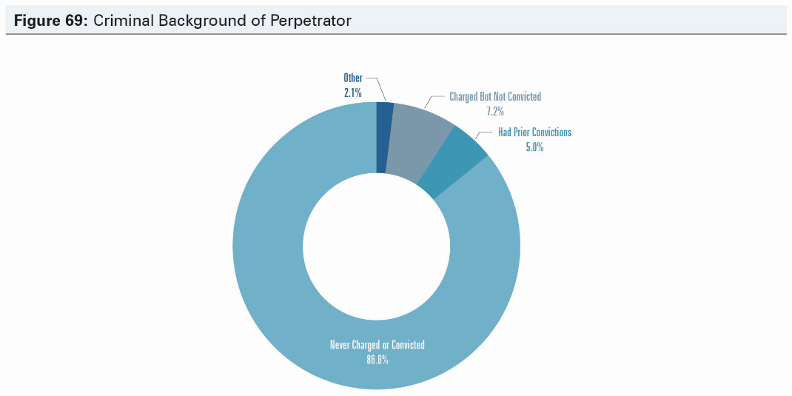
Report To The Nation
©2014 Association of Certified Fraud Examiners, Inc.

Slide 24
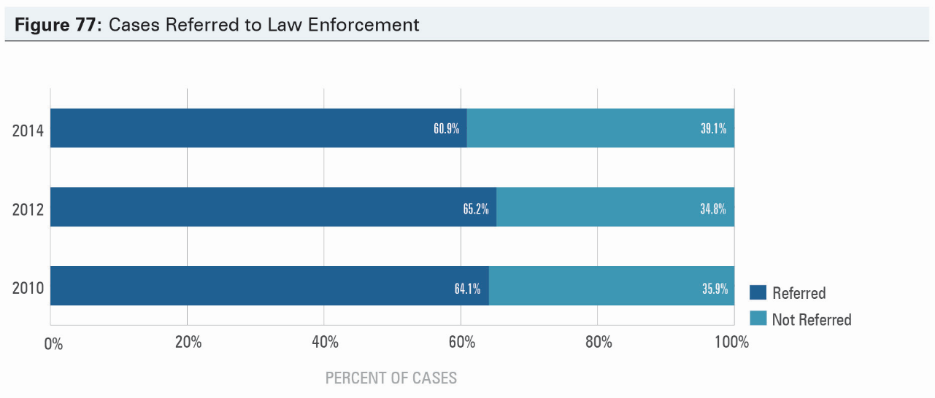
Report To The Nation
©2014 Association of Certified Fraud Examiners, Inc.

Slide 25
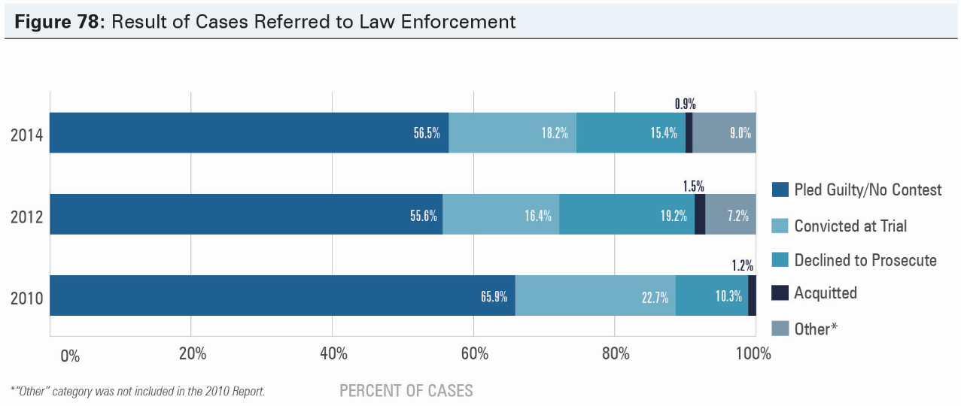
Report To The Nation
©2014 Association of Certified Fraud Examiners, Inc.

Slide 26
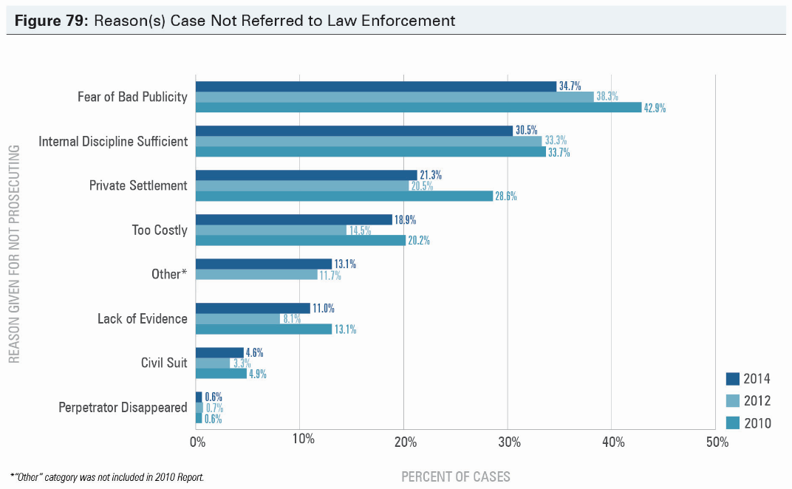
Report To The Nation
©2014 Association of Certified Fraud Examiners, Inc.

Slide 27
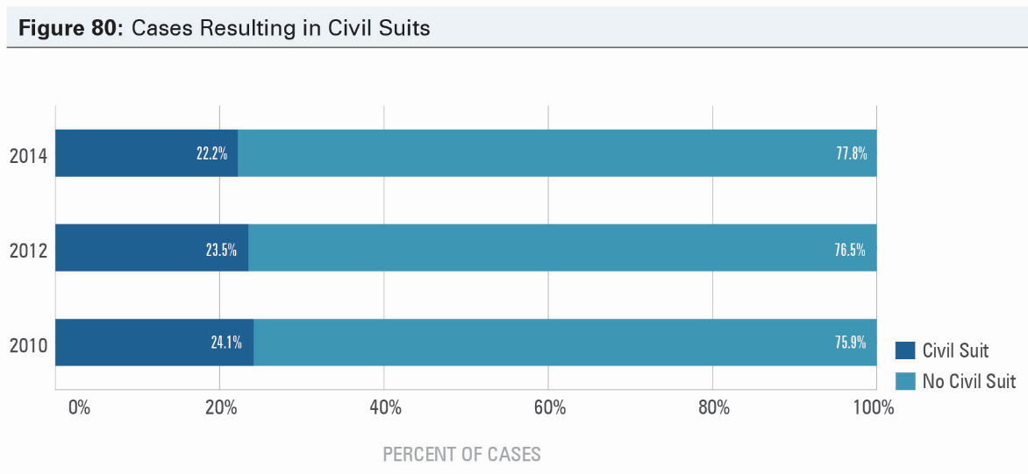
Report To The Nation
©2014 Association of Certified Fraud Examiners, Inc.

Slide 28
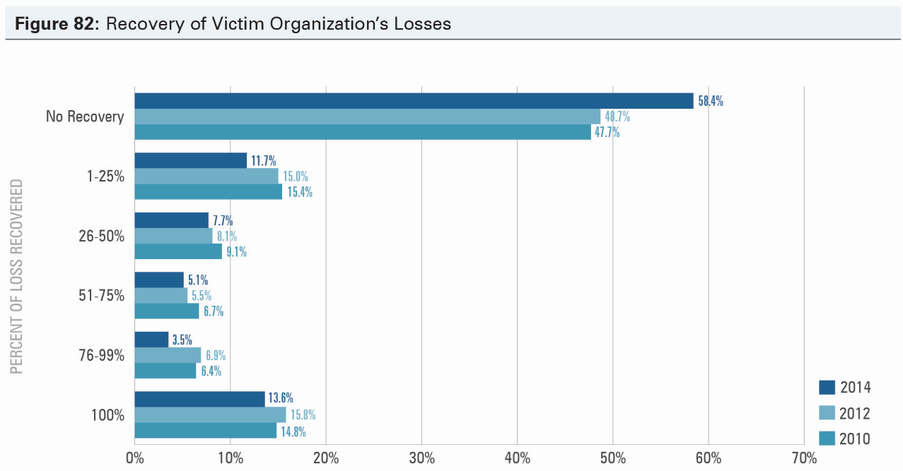
Report To The Nation
©2014 Association of Certified Fraud Examiners, Inc.

Slide 29
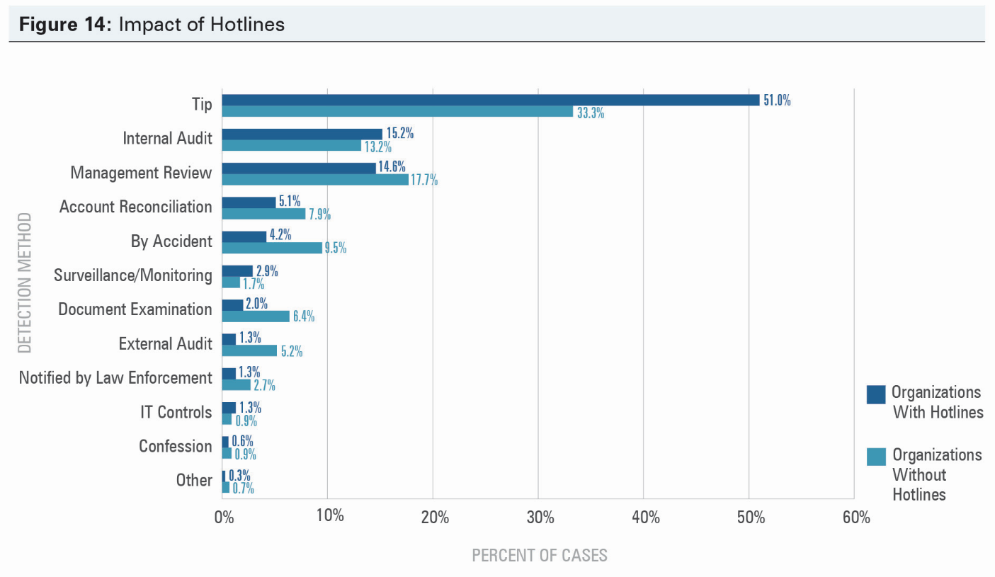
Report To The Nation
Organizations with hotlines were much more likely to catch fraud by a tip, which our data shows is the most effective way to detect fraud. These organizations also experienced frauds that were 41% less costly, and they detected frauds 50% more quickly.
©2014 Association of Certified Fraud Examiners, Inc.

Slide 30
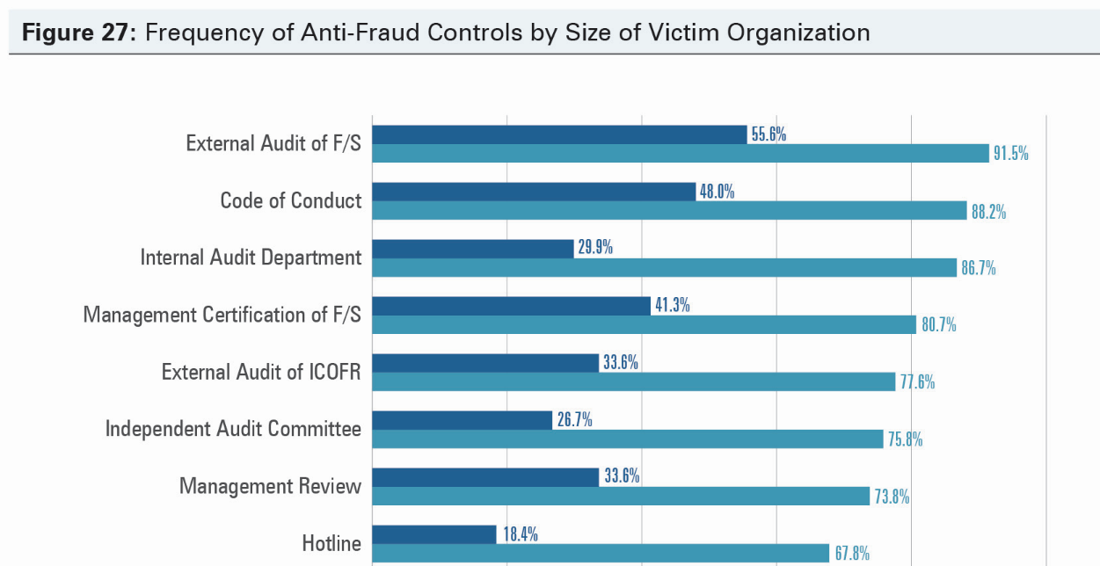
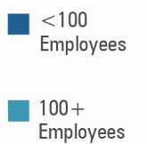
Report To The Nation
©2014 Association of Certified Fraud Examiners, Inc.

Slide 31
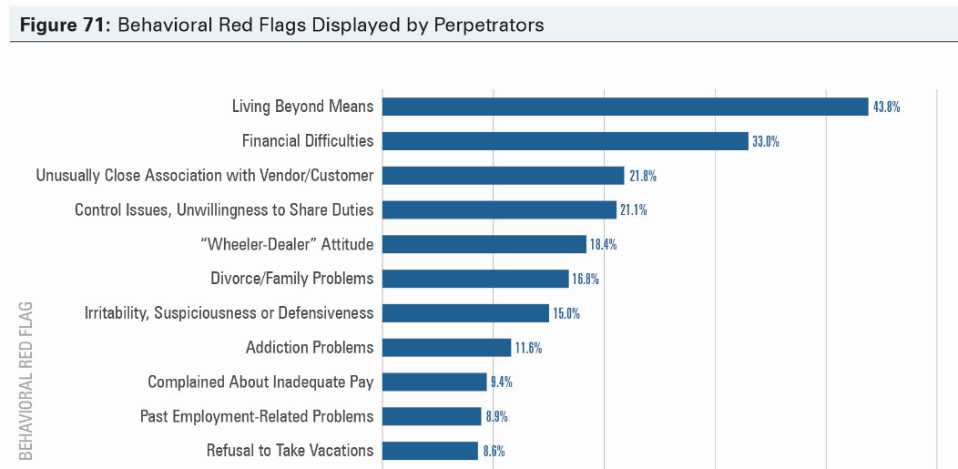
Report To The Nation
©2014 Association of Certified Fraud Examiners, Inc.

Slide 32
Receivership

Slide 33
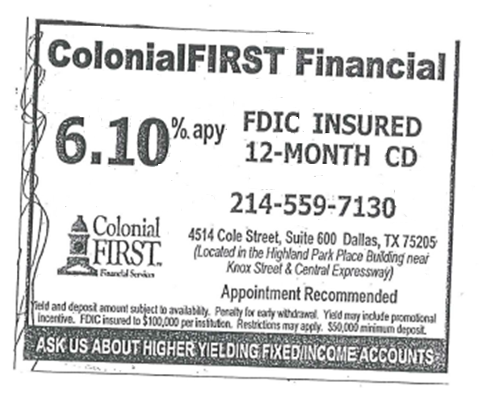
The Bait

Slide 34

The Switch

Slide 35
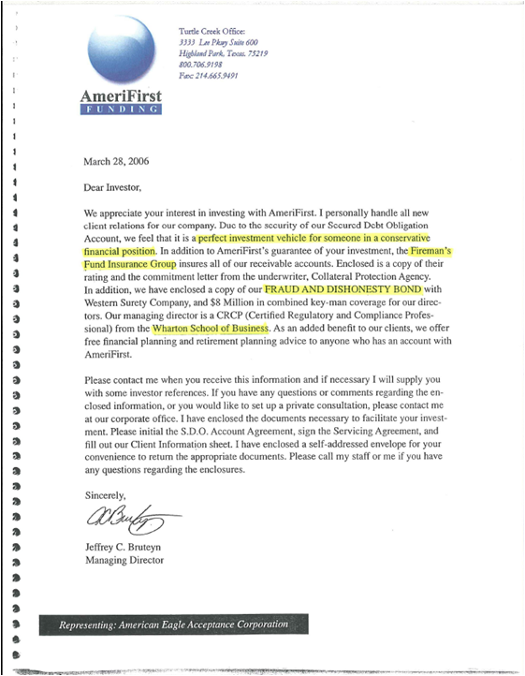
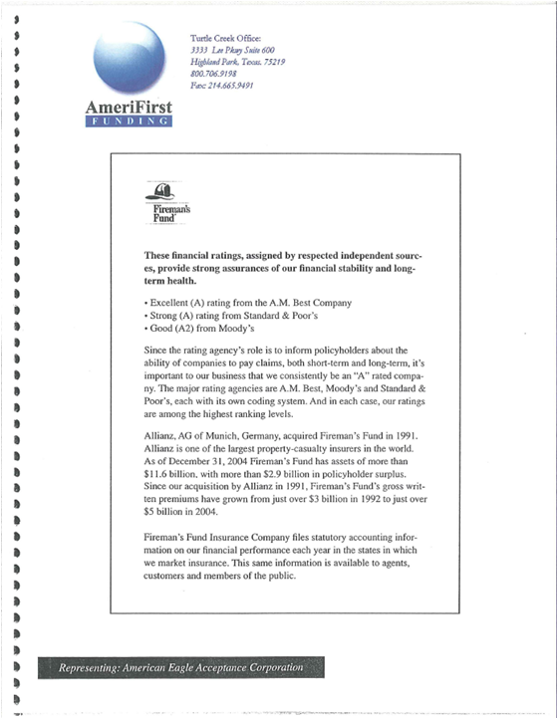
AmeriFirst Funding

Slide 36
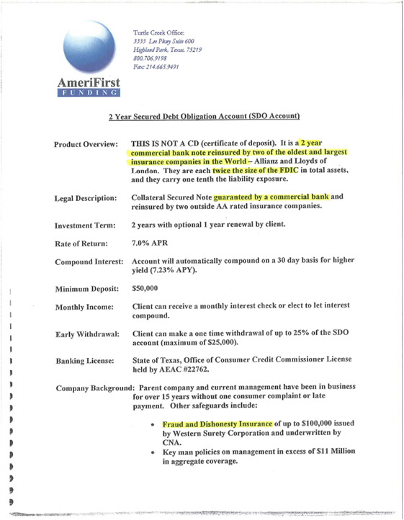
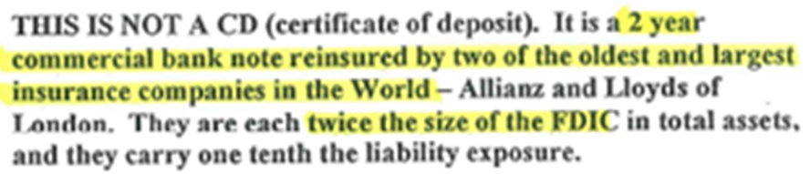
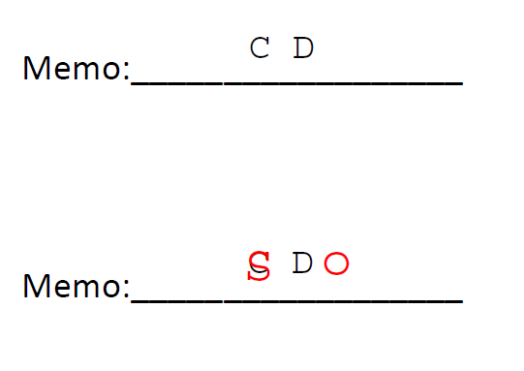
AmeriFirst Funding

Slide 37
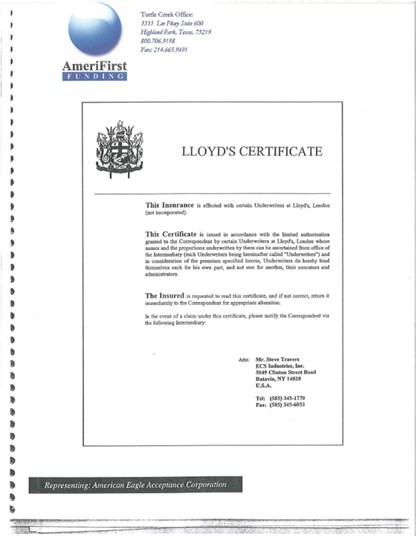
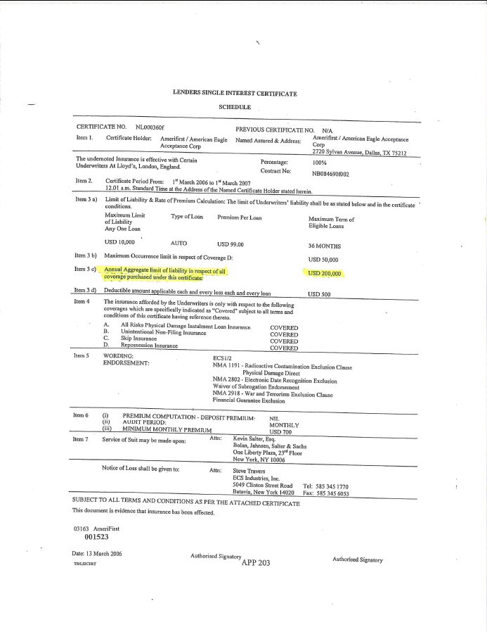
AmeriFirst Funding

Slide 38
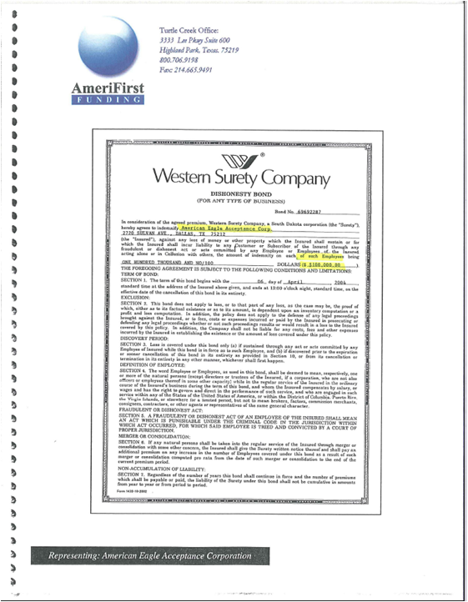
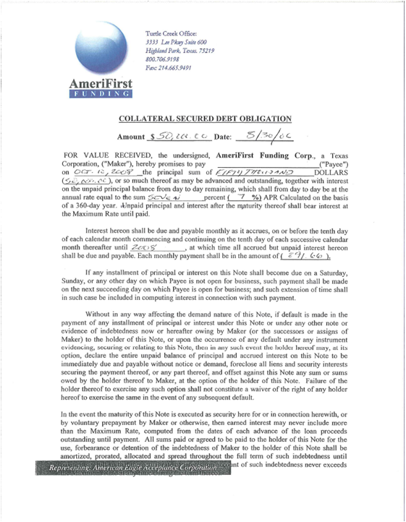
AmeriFirst Funding

Slide 39
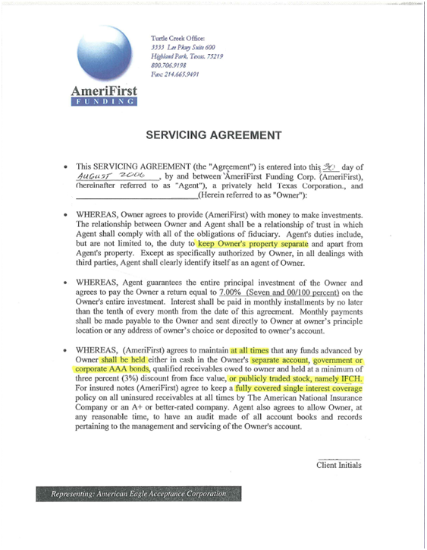
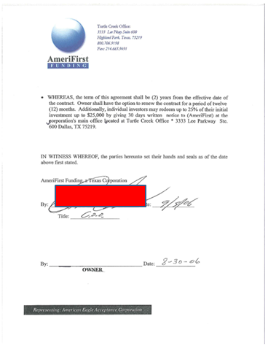
AmeriFirst Funding

Slide 40
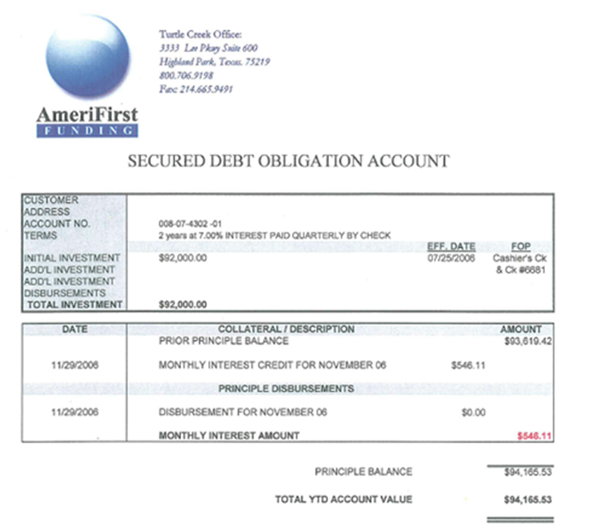
AmeriFirst Funding

Slide 41
Damage
From 2006-2007
Over 500 Investors from TX and FL.
  Total $60,000,000 invested
    1/3 – Monthly Interest Payments
    2/3 – Rollover

Slide 42
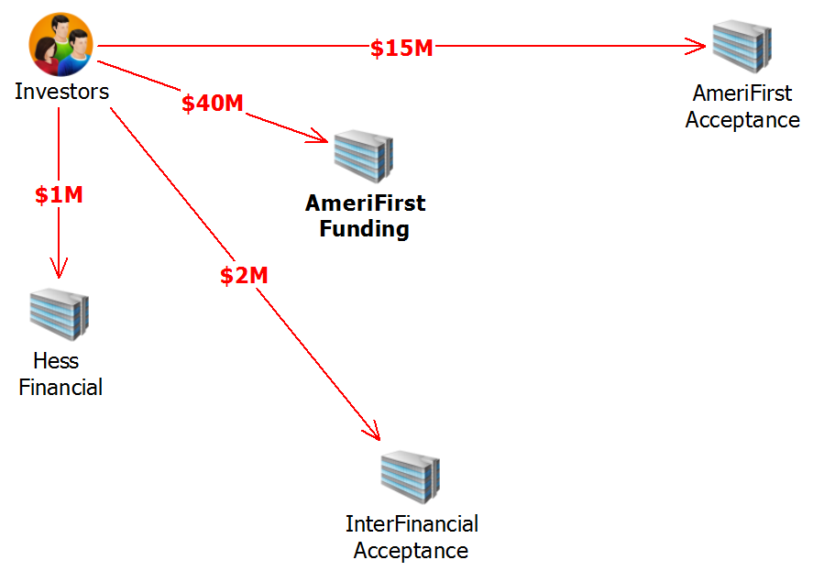
Organization

Slide 43
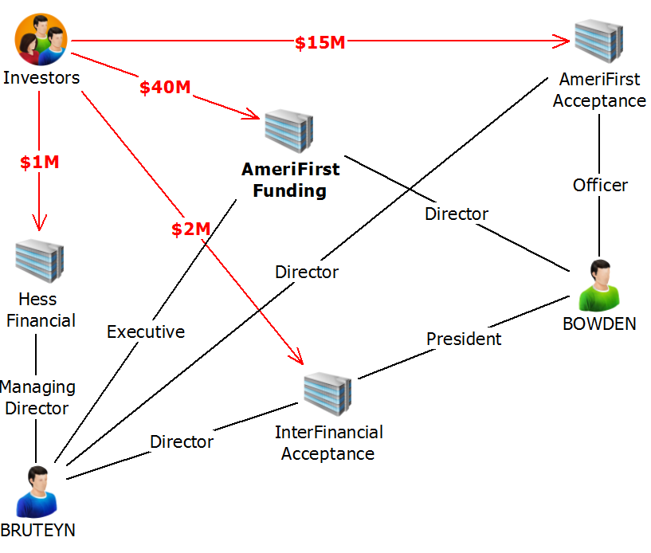
Organization

Slide 44
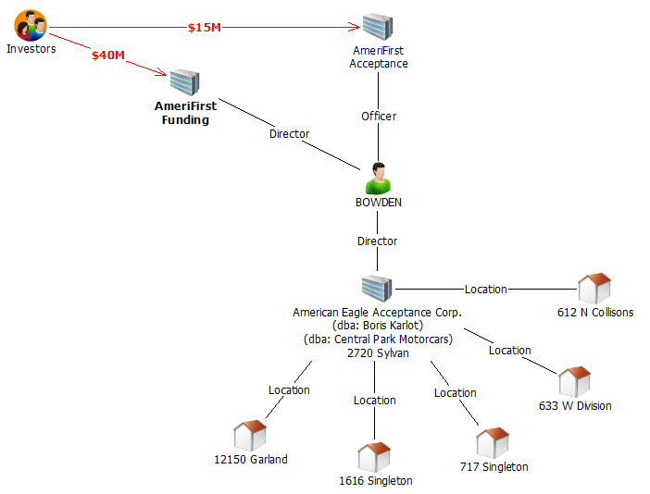
Organization

Slide 45
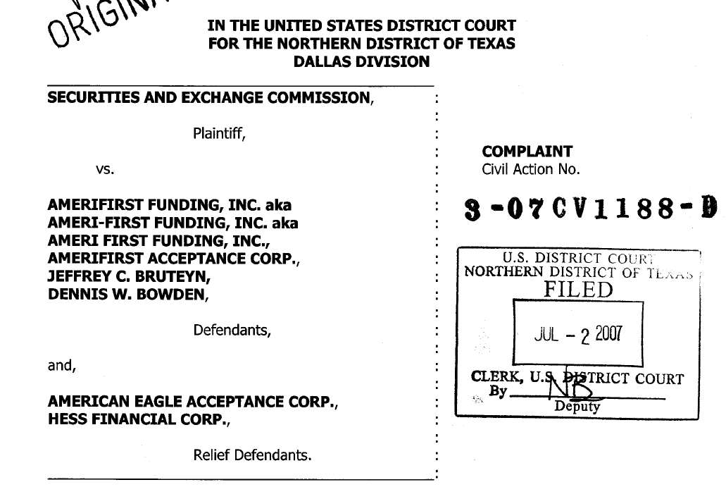
SEC Complaint

Slide 46
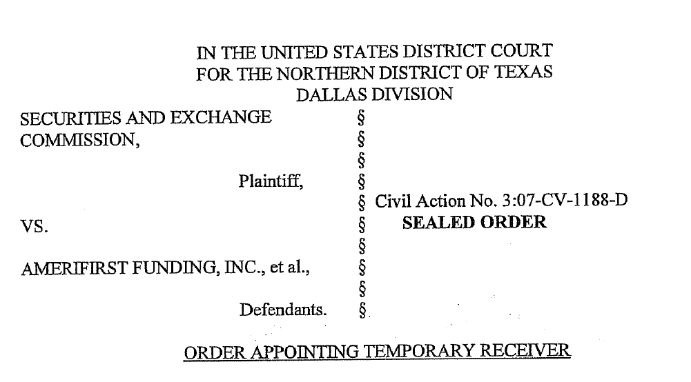
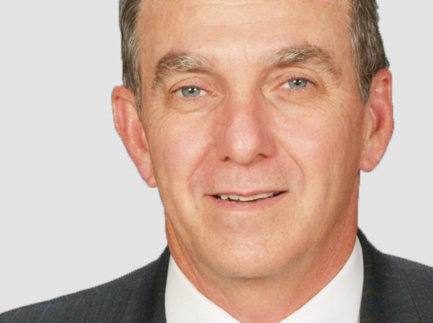
Appointing Receiver

Slide 47
The Seizure
Seizure Team
8 Locations
35 Team Members
  Accountants
  Computer Forensics Specialists
  Former Law Enforcement

Slide 48
The Seizure
Computers Seized
70 Computers Seized
3 Servers
17 Forensic Images Made
Restored Systems

Slide 49
Number of Car Notes
At time of seizure
Total 1,314
Total Current 228
Total >91 Days 351
Cars Repo’s & Sold 1,100

Slide 50
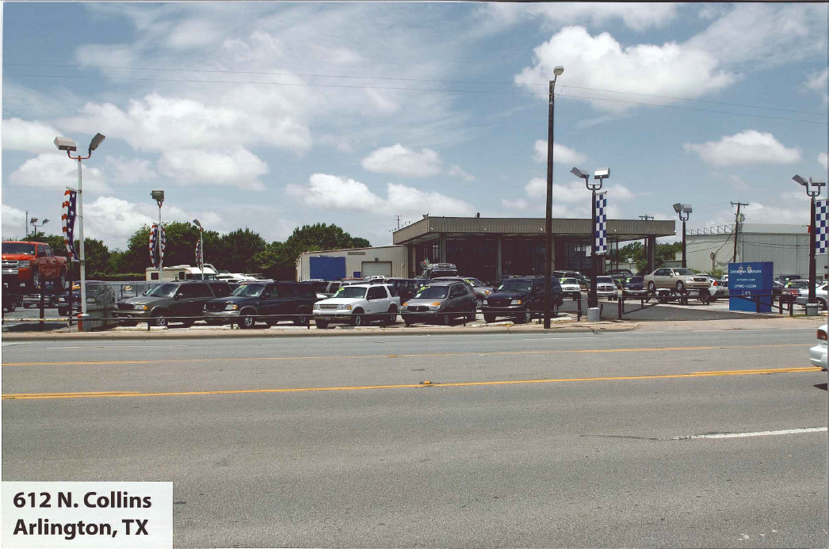
Seizure: 612 N Collins

Slide 51
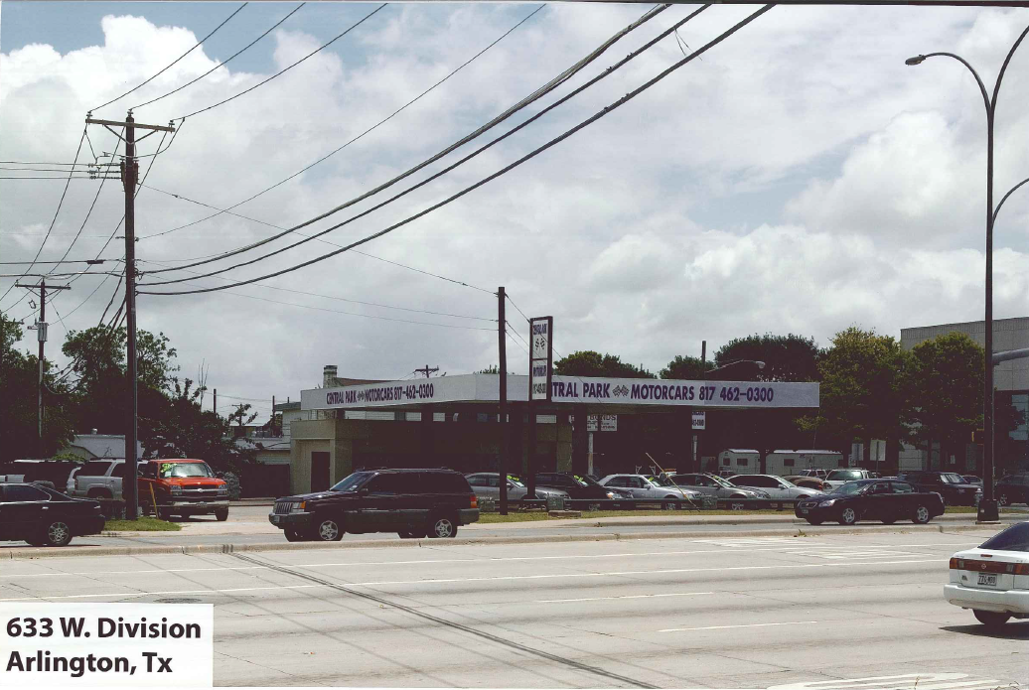
Seizure: 633 W Division

Slide 52
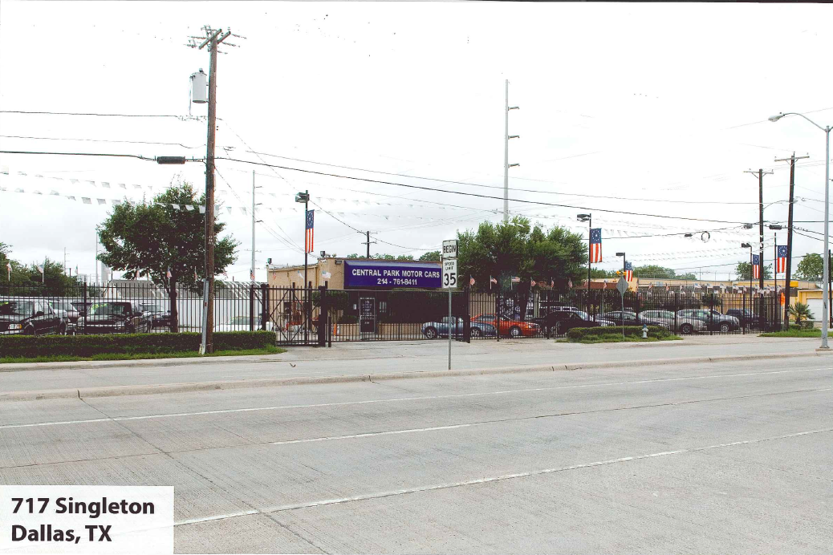
Seizure: 717 Singleton

Slide 53
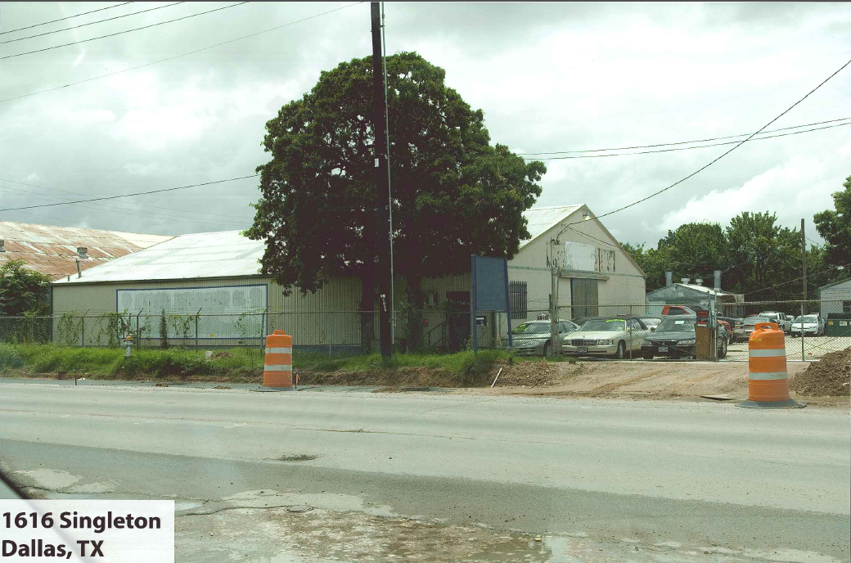
Seizure: 1616 Singleton

Slide 54
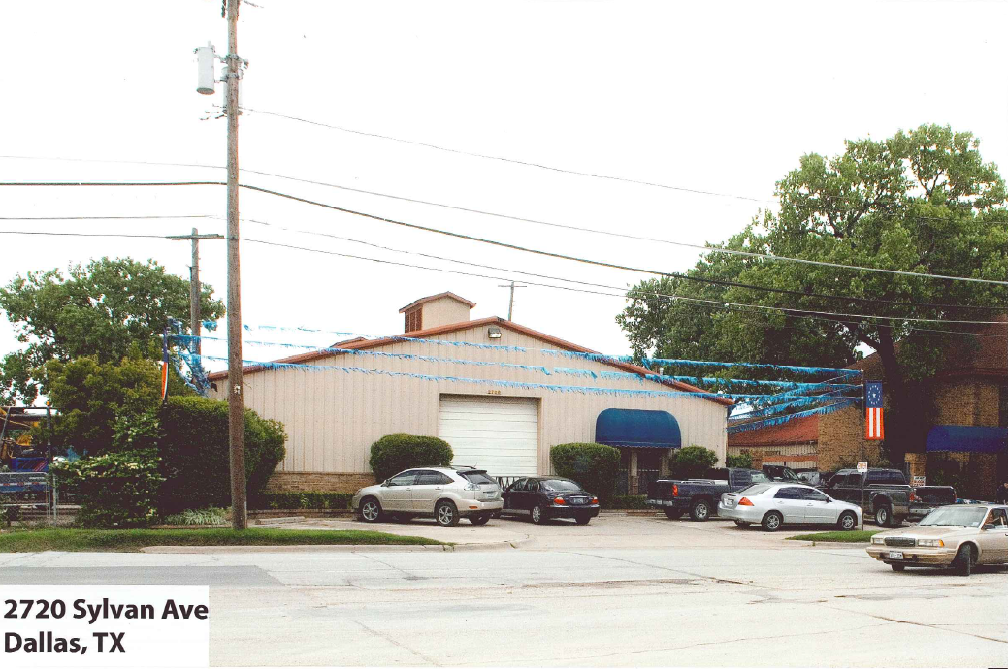
Seizure: 2720 Sylvan

Slide 55
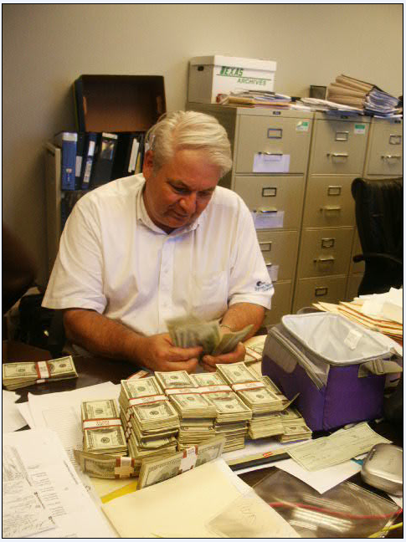
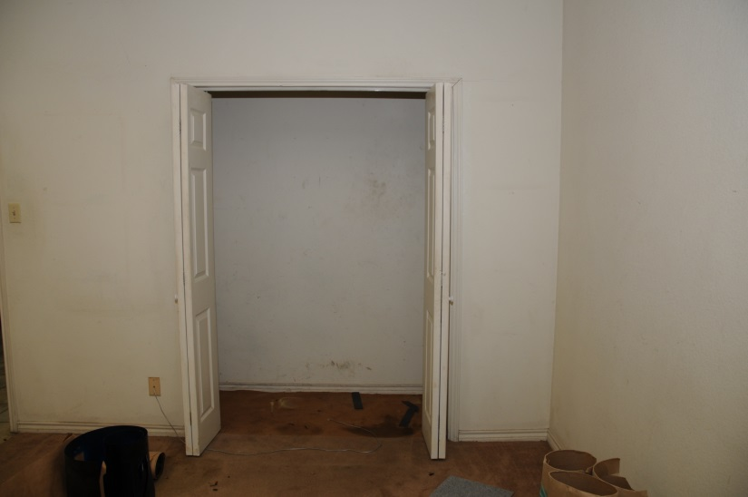
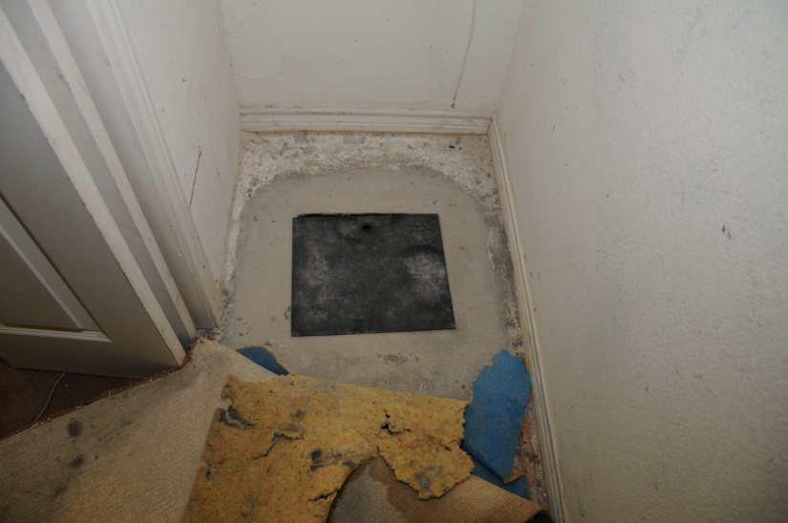
Seizure: 2720 Sylvan

Slide 56

Seizure: 12150 Garland

Slide 57


Seizure: 12150 Garland

Slide 58



Seizure: 3333 Lee Pkwy

Slide 59



Seizure: 3333 Lee Pkwy

Slide 60



Seizure: 6717 Lakewood

Slide 61



Seizure: Aston Martin

Slide 62

Seizure: Hummer H2

Slide 63



Seizure: Ferrari 355 F1 Spider

Slide 64

Seizure: Ferrari 355 F1 Spider

Slide 65

Seizure: Ferrari 355 F1 Spider

Slide 66

Seizure: Ferrari 355 F1 Spider

Slide 67



Seizure: Ferrari Maranello

Slide 68


Seizure: Ferrari Testarossa

Slide 69



Seizure: Air Plane

Slide 70



Seizure: Roatan Island

Slide 71

Receiver Report
Filed: 07/23/2007

Slide 72

Receiver Letter to Investors

Slide 73

Investment Verification Confirmation

Slide 74


Indexing Records
1,400 Boxes

Slide 75


Indexing Records

Slide 76


Vehicle Reposses

Slide 77

Organization

Slide 78

Passport Fraud

Slide 79

Trial Preparation

Slide 80

Organization

Slide 81

Trial Preparation

Slide 82

Trial Preparation

Slide 83

Trial Preparation

Slide 84



$25,000,000 Distribution

Slide 85





Media Coverage

Slide 86

Press Release
http://www.justice.gov/usao/txn/PressRel11/bruteyn_sen_pr.html

Slide 87

Defendants
Jeffrey Charles Bruteyn, of Dallas
Former Managing Director of AmeriFirst.
Convicted on nine counts of security fraud.
Currently serving a 25 years federal prison sentence.
Ordered to pay nearly $7 million in restitution.

Slide 88



Defendants
http://www.bop.gov/locations/institutions/lat/index.jsp

Slide 89


Defendants
http://www.amazon.com/Suicidal-Kings-The-Road-Redemption/dp/1625098766

Slide 90

Press Release
http://www.justice.gov/usao/txn/PressRel11/bowden_amerifirst_conv_pr.html

Slide 91
Defendants
Dennis Woods Bowden, of Dallas
Former Chief Operations Officer of AmeriFirst Funding Corp. and AmeriFirst Acceptance Corp.
Convicted on four counts of securities fraud and five counts of mail fraud.
Currently serving 16 years federal prison sentence.
Ordered to pay nearly $23 million in restitution.

Slide 92


Defendants
http://www.bop.gov/locations/institutions/lat/index.jsp

Slide 93
Defendants
Vincent John Bazemore, Jr., of Denton
Pleaded guilty in October 2007 to his role in the scheme, as the broker who sold the SDOs.
Currently serving a 5 years federal prison sentence.
Ordered to pay nearly $16 million in restitution.
Gerald Kingston, of Dallas
Pleaded guilty in December 2007 to one count of conspiracy to commit securities fraud for helping Bruteyn to manipulate the stock price of Interfinancial Holdings Corporation (ticker: IFCH).
Currently serving 2 years probation.
Ordered to pay nearly $1.6 million in restitution and a $50,000 fine.

Slide 94
Defendants
Eric Hall, of Fort Myers, Florida
Pleaded guilty in June 2008 to one count of securities fraud, based on his role in a scheme to defraud investors in an entity called Secured Capital Trust.
Currently serving 2 years probation.
Restitution of $4.7 million.
John Porter Priest, of Ocala, Florida
Broker for Secured Capital Trust scheme.
Pleaded guilty in September 2010 to one count of securities fraud based on his role in the Secured Capital Trust scheme.
Currently serving 1 year in federal prison.
Restitution of $4.7 million.

Slide 95
Defendants
Phillip Offill, of Dallas
Attorney who registered companies.
Convicted in Virginia on nine counts of wire fraud and a single count of conspiracy for his role in penny stock scams.
Sentenced to 8 years in federal prison.

Slide 96
Amerifirst Overview
Order Signed July 2, 2007
545 Investors from TX and FL.
  $62,000,000 invested
  $58,760,000 net loss
  $48,941,038 seized
  $35,000,000 returned to investors
  7 criminal convictions
  13 civil lawsuits
  Authorization to close receivership approved

Slide 97
Diverse Services
Asset tracing/seizure
Investor accounting (determine claims)
Federal, state and local tax returns
Testify in civil & criminal cases
Operate 5 used car lots
Collections on 1,420 sub-prime car notes ($4.6 million collected)
Repo & auction 1,200 cars ($5.0 million)

Slide 98
ACFE

Slide 99

ACFE
Association of Certified Fraud Examiners (ACFE):
70,000 members
More than 150 countries
Designation Certified Fraud Examiner (CFE)
  http://www.acfe.com/

Slide 100

Dallas Chapter-ACFE
Student Associate Member
Annual dues for student membership are $10, and do not include ACFE dues.
Student Scholarship Opportunities
The ACFE Dallas Chapter is offering four separate $1,000 scholarships.
  http://www.dallasacfe.org/Student_Center/

Slide 101
Dallas Chapter-ACFE
Student Contact :
Mike Rogers, Director
Email: Miker@plano.gov
  http://www.dallasacfe.org/Student_Center/

Slide 102
Fraud & Perpetrators
Paul Bustos, CFE, CRMA: Forensic & Litigation Services
Tele: 817-882-7341 or 972-448-9251
E-mail: Paul.Bustos@Weaver.com

